Slide 1
Office Leave Management System
- Bharath Kumar palasa

Slide 2
Introduction
The Office Leave Management System is an innovative solution designed to streamline and automate the process of managing employee leave requests.
This system provides a centralized platform for employees to submit leave requests, track their leave balances, and receive approvals from their managers.

Slide 3
The Office Leave Management System offers a range of features that make it easy for both employees and managers to manage leave requests. These features include automated leave balance calculations, customizable leave policies, and real-time status updates on leave requests.

Slide 4
Technologies :
JAVA – 8
Spring boot
Rest API
My SQL
Spring Data JPA
Spring Security
Jasper Reports
Swagger
Junit
Sonal Qube

Slide 5
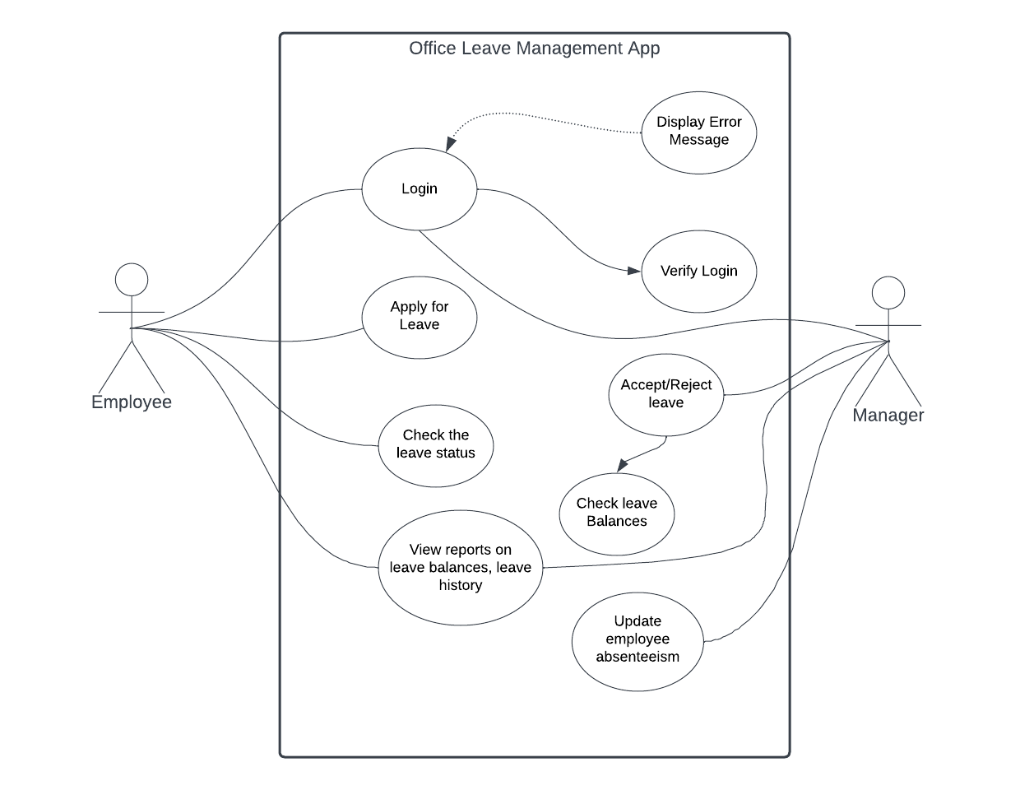
Use Case UML Diagram

Slide 6
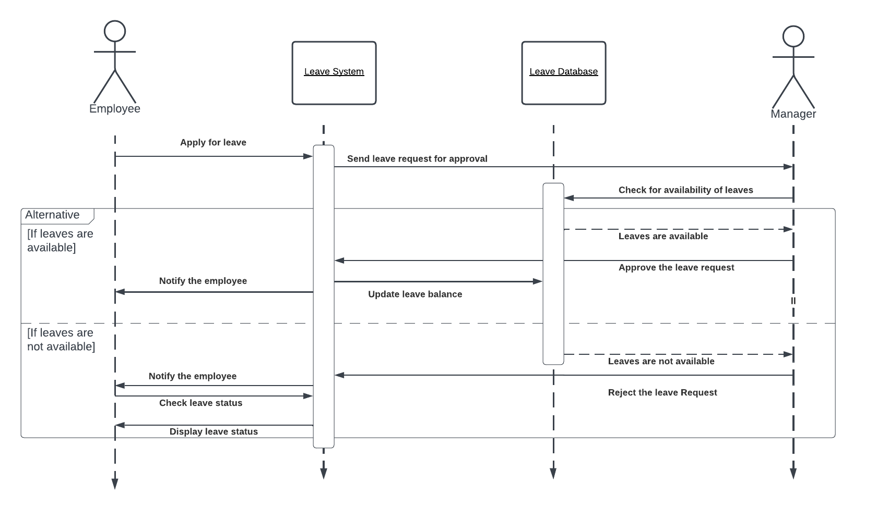
Use Case UML Diagram

Slide 7
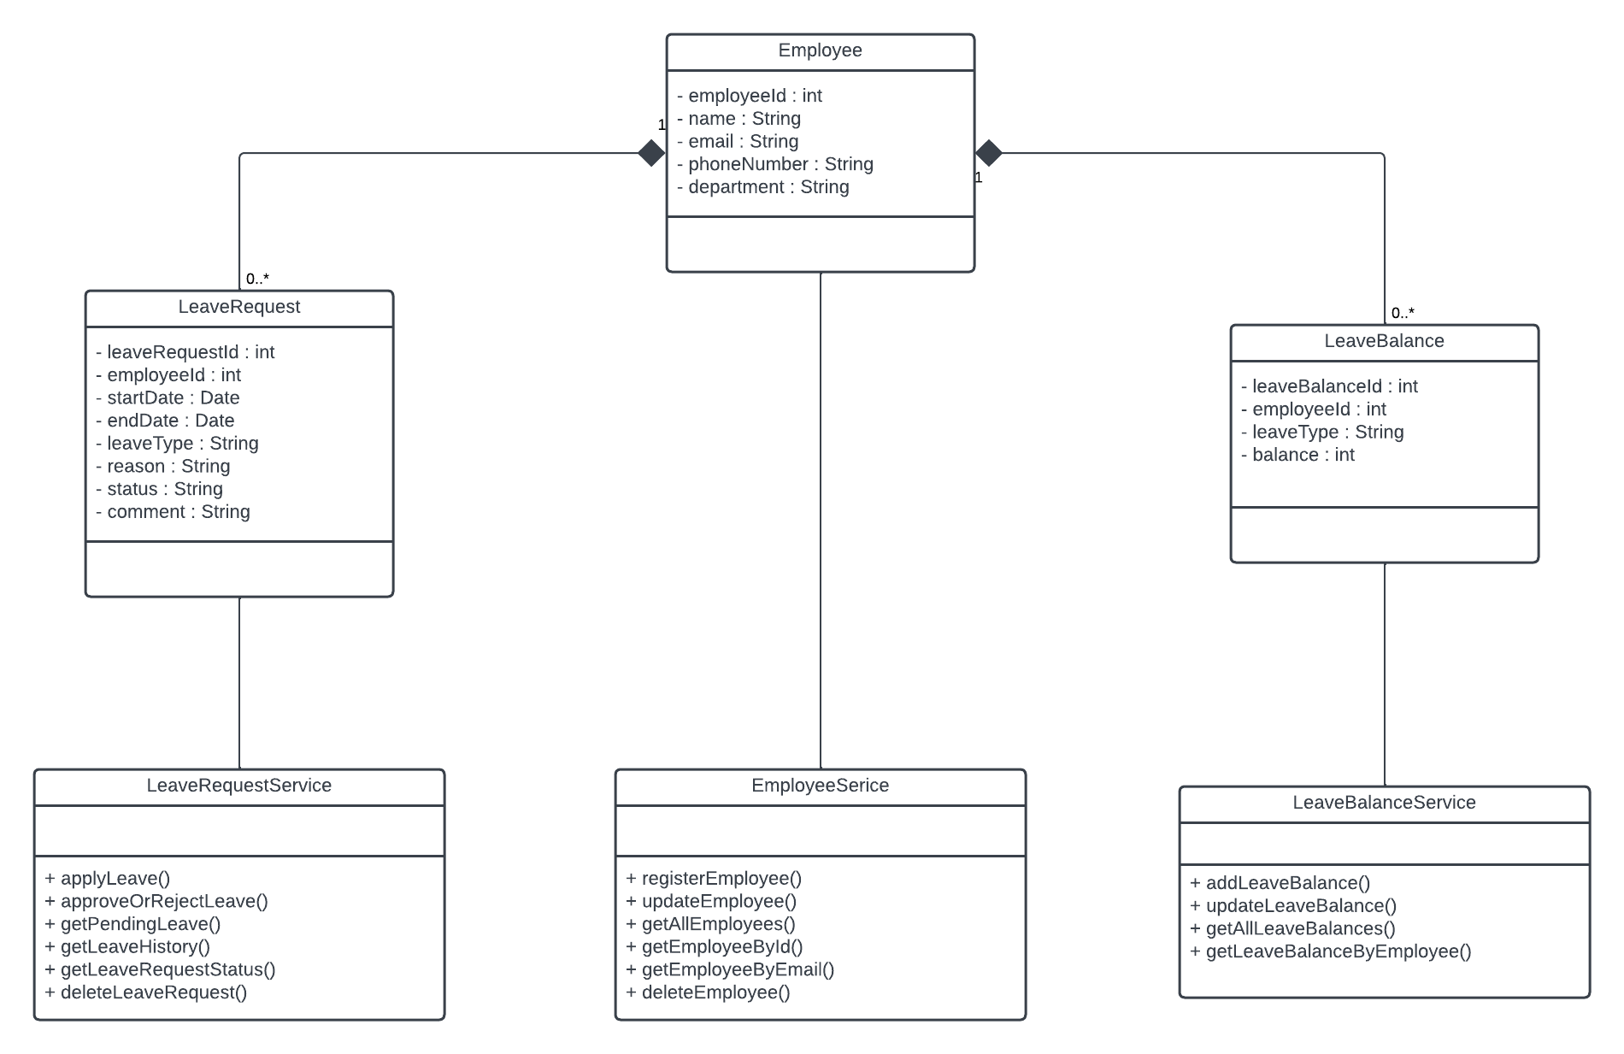
Class UML Diagram

Slide 8
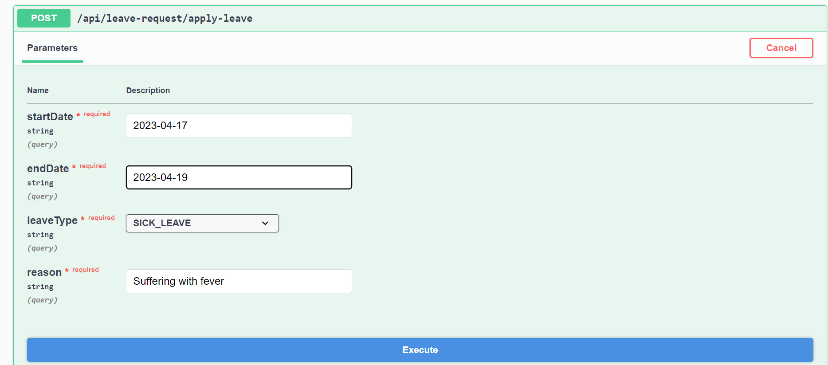
Apply for leave

Slide 9
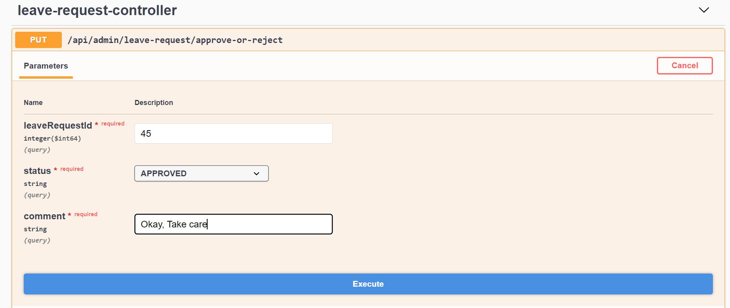
Approve or Reject the Leave

Slide 10
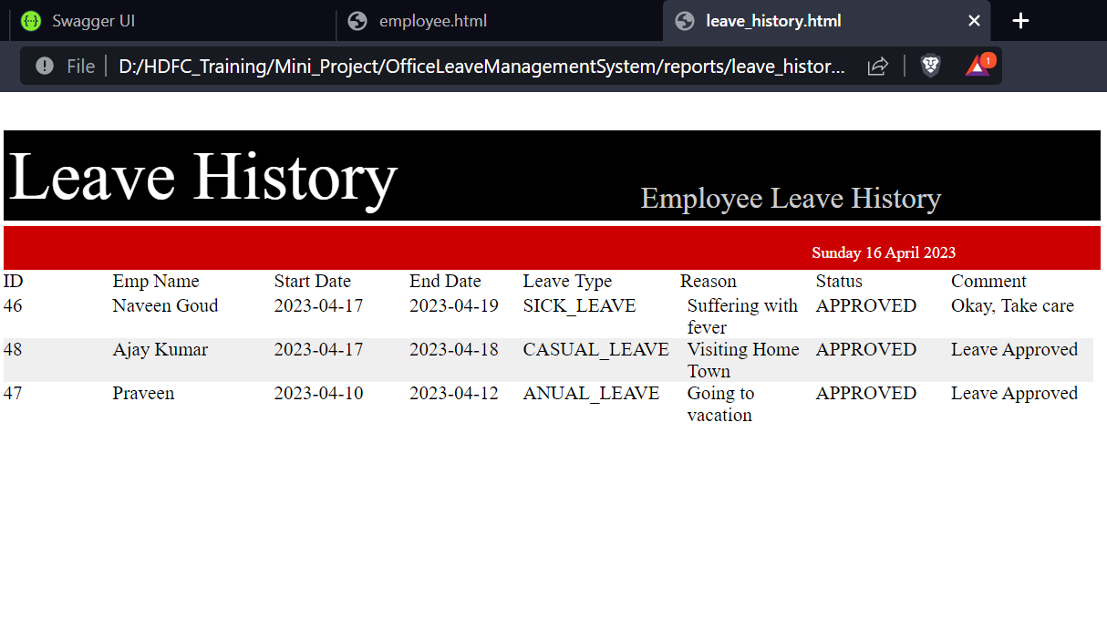
Leave History Report

Slide 11
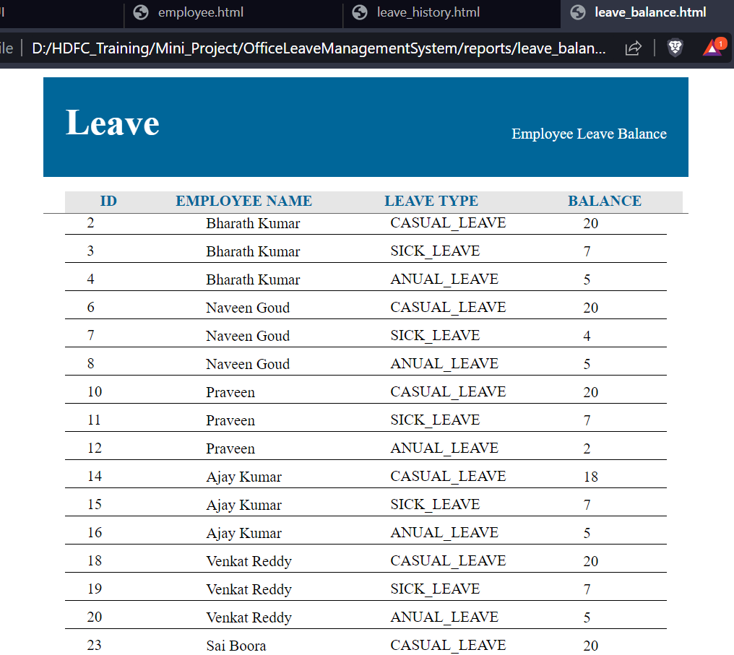
Leave Balance Report

Slide 12
Conclusion
In conclusion, the Office Leave Management System is a powerful tool that can help organizations of all sizes to streamline their leave management process and improve overall efficiency.

